Slide 1
Digital Image Processing Lecture – 6
Course Teacher:
Md. Rayhan Ahmed
Rayhan@cse.uiu.ac.bd

Slide 2
Fundamentals of Spatial Filtering
The name filter is borrowed from frequency domain processing where “filtering” refers to passing, modifying, or rejecting specified frequency components of an image.
For example, a filter that passes low frequencies is called a lowpass filter (i.e. smoothing). Highpass filter (i.e. sharpening) that passes high frequencies: used for sharpening the image.
The net effect produced by a lowpass filter is to smooth an image by blurring it.
We can accomplish similar smoothing directly on the image itself by using spatial filters (also called masks, kernels, windows or templates).
Uses:
Enhance images • Noise reduction, smooth, resize, increase contrast, recolor, artistic effects, etc.
Extract features from images • Texture, edges, distinctive points, etc.
Detect patterns • Template matching, e.g., eye template

Slide 3
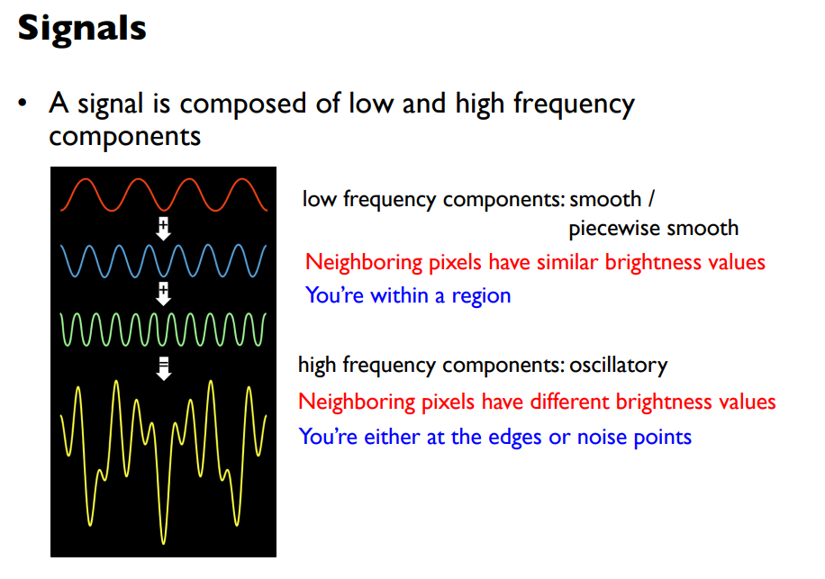
Fundamentals of Spatial Filtering

Slide 4
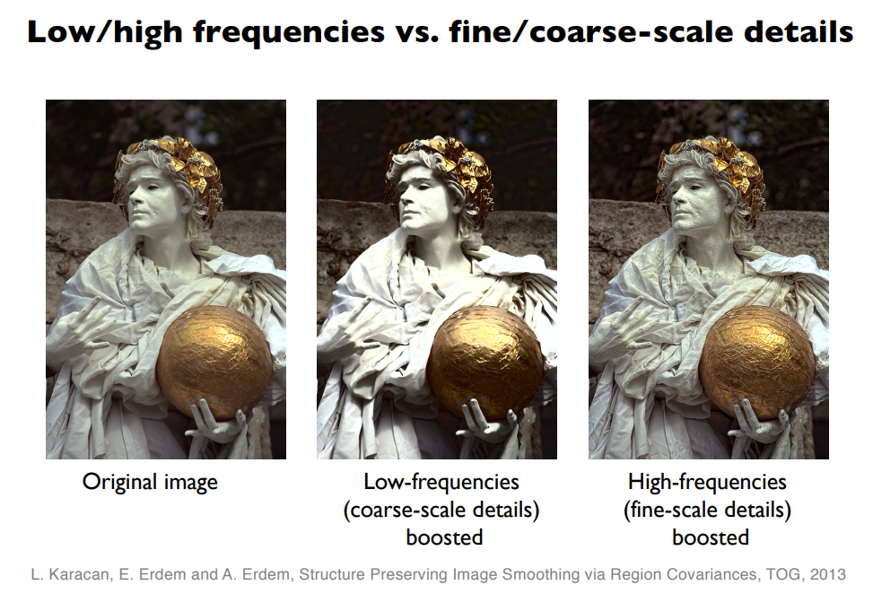
Fundamentals of Spatial Filtering

Slide 5
Fundamentals of Spatial Filtering
Filters in spatial domain:
Spatial filtering modifies an image by replacing the value of each pixel by a function of the values of the pixel and its neighbors.
If the operation performed on the image pixels is linear, then the filter is called a linear spatial filter. Otherwise, the filter is a nonlinear spatial filter.
Spatial Filtering technique is used directly on pixels of an image. Mask is usually considered to be added in size so that it has specific center pixel.
This mask is moved on the image such that the center of the mask traverses all image pixels.

Slide 6
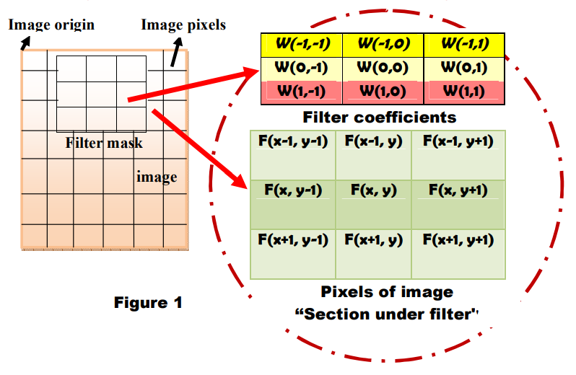
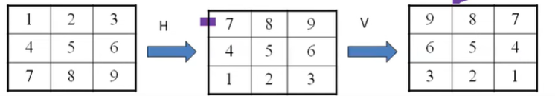
Fundamentals of Spatial Filtering
LINEAR SPATIAL FILTERING: The average of the pixels contained in the neighborhood of the filter mask.
Correlation
The process of moving a filter mask over the image and computing the sum of products at each location.
Correlation is used to check the similarity between two images.
Convolution
The same process as correlation, except that the filter is first rotated by a degree of 180.
Figure 1 presents the mechanics of linear
spatial filtering using a 3*3 neighborhood.

Slide 7
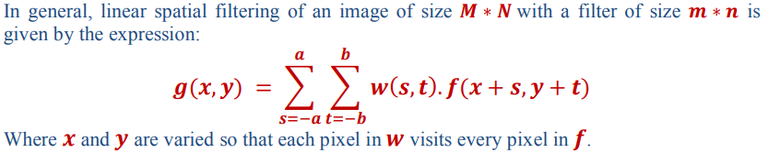
Fundamentals of Spatial Filtering
The response (output) g(x,y) of the filter at any point (x,y) in the image is the sum of products of the filter coefficients and the image pixels values:
𝑔(𝑥, 𝑦) = 𝑤(−1, −1)𝑓(𝑥 − 1, 𝑦 − 1) + 𝑤(−1,0)𝑓(𝑥 − 1, 𝑦) + ⋯ + 𝑤(0,0)𝑓(𝑥, 𝑦) + ⋯ + 𝑤(1,1)𝑓(𝑥 + 1, 𝑦 + 1) .
For a kernel of size (𝑚, 𝑛), we assume that 𝑚 = 2𝑎 + 1 and 𝑛 = 2𝑏 + 1, where 𝑎 and 𝑏 are nonnegative integers. This means that our focus is on kernels of odd size in both coordinate directions.

Slide 8
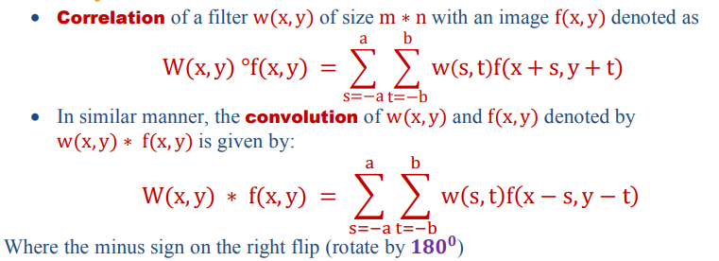
Fundamentals of Spatial Filtering

Slide 9
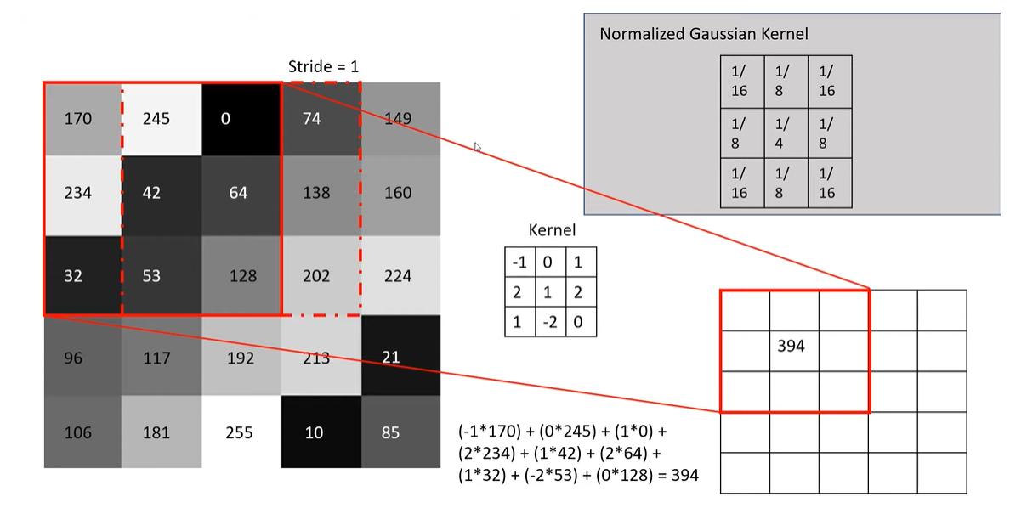
Fundamentals of Spatial Filtering

Slide 10
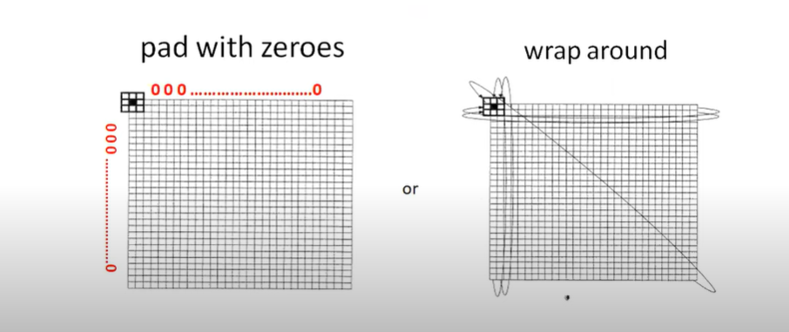
Fundamentals of Spatial Filtering
Handling pixels close to boundaries

Slide 11
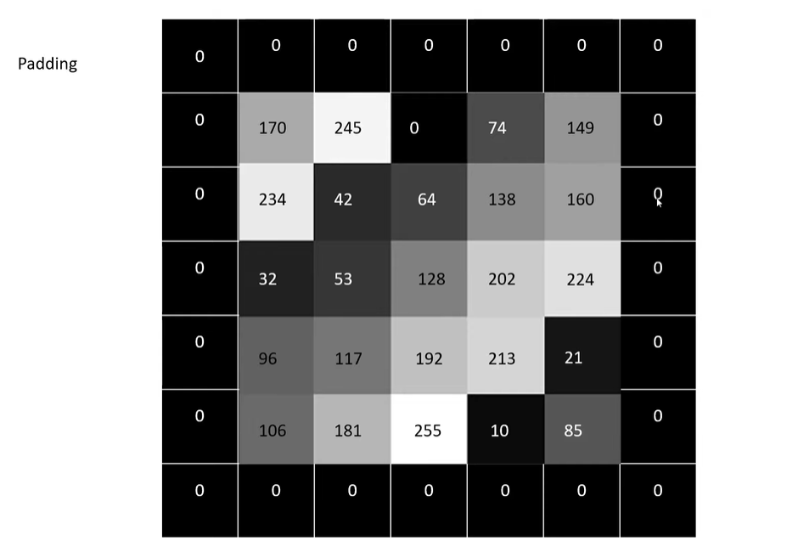
Fundamentals of Spatial Filtering

Slide 12
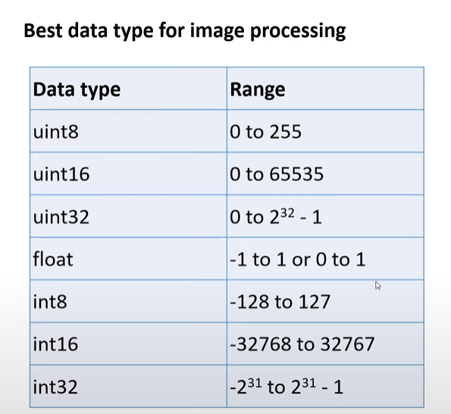
Fundamentals of Spatial Filtering

Slide 13
Fundamentals of Spatial Filtering
SMOOTHING (LOWPASS) SPATIAL FILTERS
Smoothing (also called averaging) spatial filters are used to reduce sharp transitions in intensity. Because random noise typically consists of sharp transitions in intensity, an obvious application of smoothing is noise reduction.
Smoothing is used to reduce irrelevant detail in an image, where “irrelevant” refers to pixel regions that are small with respect to the size of the filter kernel.
Linear spatial filtering consists of convolving an image with a filter kernel.
Convolving a smoothing kernel with an image blurs the image, with the degree of blurring being determined by the size of the kernel and the values of its coefficients.

Slide 14
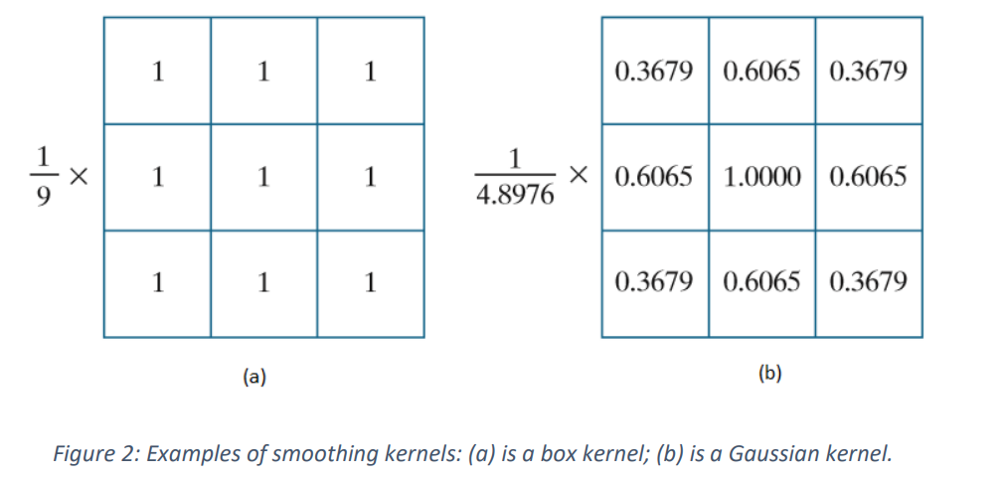
Fundamentals of Spatial Filtering
SMOOTHING (LOWPASS) SPATIAL FILTERS
1. BOX FILTER KERNELS
The simplest, separable lowpass filter kernel is the box kernel, whose coefficients have the same value (typically 1). The name “box kernel” comes from a constant kernel resembling a box when viewed in 3-D. We show a 3 × 3 box filter in Fig. 2(a). An 𝑚 × 𝑛 box filter is an 𝑚 × 𝑛 array of 1’s, with a normalizing constant in front, whose value is 1 divided by the sum of the values of the coefficients (i.e., 1 /mn when all the coefficients are 1’s).

Slide 15
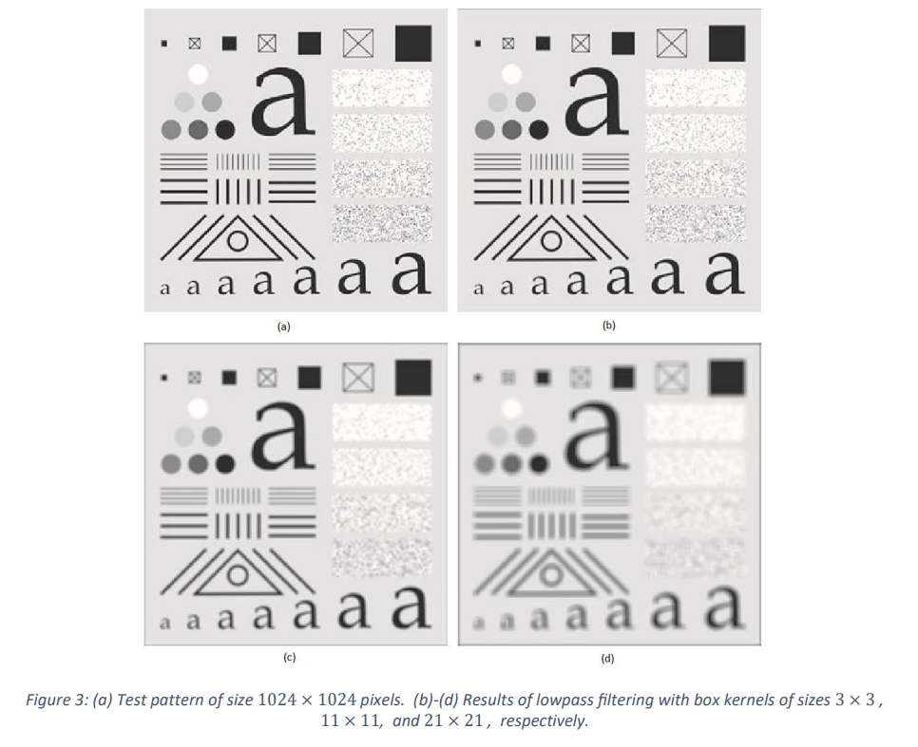
Fundamentals of Spatial Filtering

Slide 16
Fundamentals of Spatial Filtering
2. LOWPASS GAUSSIAN FILTER KERNELS
Because of their simplicity, box filters are suitable for quick experimentation and they often yield smoothing results that are visually acceptable. They are useful also when it is desired to reduce the effect of smoothing on edges. However, box filters have limitations that make them poor choices in many applications.
For example, a defocused lens is often modeled as a lowpass filter, but box filters are poor approximations to the blurring characteristics of lenses.
Another limitation is the fact that box filters favor blurring along perpendicular directions. In applications involving images with a high level of detail, or with strong geometrical components, the directionality of box filters often produces undesirable results.
Gaussian kernels have to be larger than box filters to achieve the same degree of blurring. This is because, whereas a box kernel assigns the same weight to all pixels, the values of Gaussian kernel coefficients (and hence their effect) decreases as a function of distance from the kernel center.

Slide 17
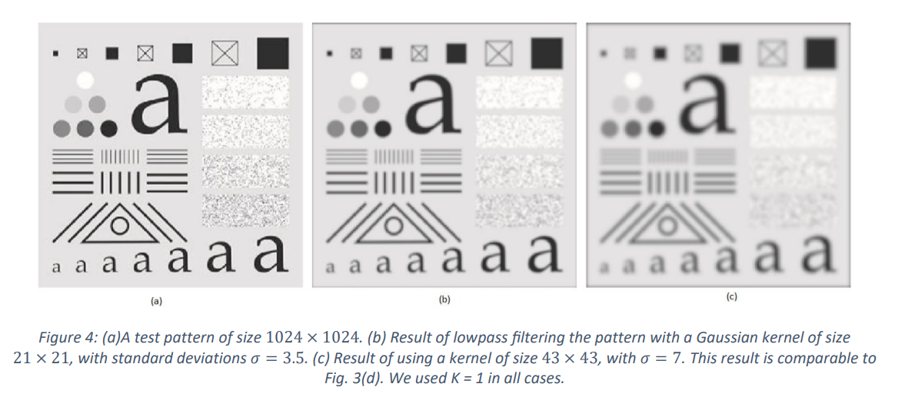
Fundamentals of Spatial Filtering

Slide 18
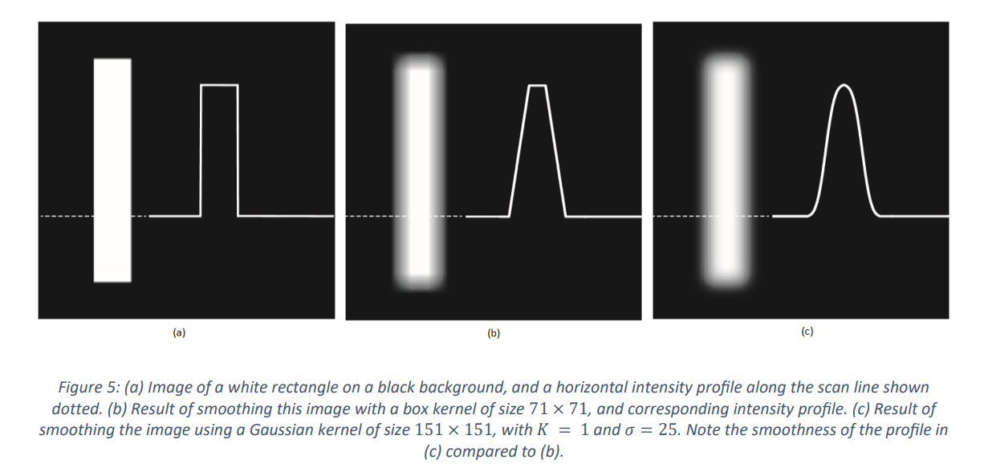
Fundamentals of Spatial Filtering

Slide 19
Fundamentals of Spatial Filtering
Discussion:
The results in figures 3 and 4 showed little visual difference in blurring. Despite this, there are some subtle differences that are not apparent at first glance. For example, compare the large letter “a” in Figs. 3(d) and 4(c); the latter is much smoother around the edges. Figure 5 shows this type of different behavior between box and Gaussian kernels more clearly. The image of the rectangle was smoothed using a box and a Gaussian kernel with the sizes and parameters listed in the figure.

Slide 20

Fundamentals of Spatial Filtering
Sharpening Spatial Filters
To highlight fine detail in an image or to enhance detail that has been blurred, either in error or as a natural of a particular method of image acquisition.
Sharpening filters makes transition between features more recognizable and obvious as compared to smooth and blurry pictures.
But at the cost of image noise.
Blurring vs. Sharpening
Blurring/smooth is done in spatial domain by pixel averaging in a neighbors, it is a process of integration
Sharpening is an inverse process, to find the difference by the neighborhood, done by spatial differentiation.
Example of a sharpening kernel is shown below :

Slide 21
Fundamentals of Spatial Filtering
Different types of Sharpening Filters
There are various methods of sharpen filtering depending on applications: i) High pass filtering. ii) High boost filtering. iii) Derivative filtering.

Slide 22
Some Useful links
https://setosa.io/ev/image-kernels/
https://www.albertogramaglia.com/linear-smoothing-filters-for-image-processing/
https://towardsdatascience.com/basics-of-kernels-and-convolutions-with-opencv-c15311ab8f55
https://medium.com/swlh/image-processing-with-python-convolutional-filters-and-kernels-b9884d91a8fd
https://github.com/nikhilsinghh59/Opengenus_articles/blob/master/Sharpening_filters.ipynb

